Slide 1
Yocto Project

Slide 2
Agenda
Yocto Project Overview
Yocto Project Usage
Summary

Slide 3
Yocto Project Overview

Slide 4
What is Yocto Project?
The Yocto Project is not an SDK that you can use for your hardware machine – it can be used to build one!
The Yocto Project is not a system binary image that you can deploy on your hardware machine – it can be used to build one!
The Yocto Project is not a linux distribution that you can use to install to your hardware machine – it can be used to build an extremely tailored one for your resource-constrained hardware machine

Slide 5

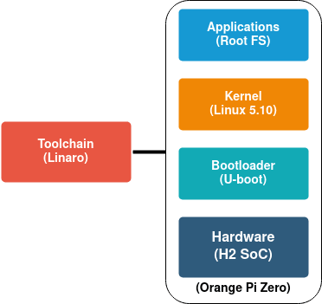
What is Yocto Project?
The Yocto Project is an open-source collaboration project that helps developers create rootfs, kernel, bootloader, toolchain for embedded products, regardless of the hardware architecture.

Slide 6
Yocto Project Usage

Slide 7

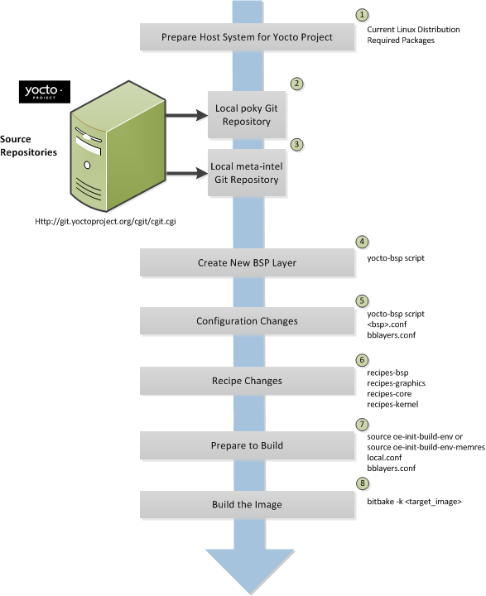



Build Workflow

Slide 8
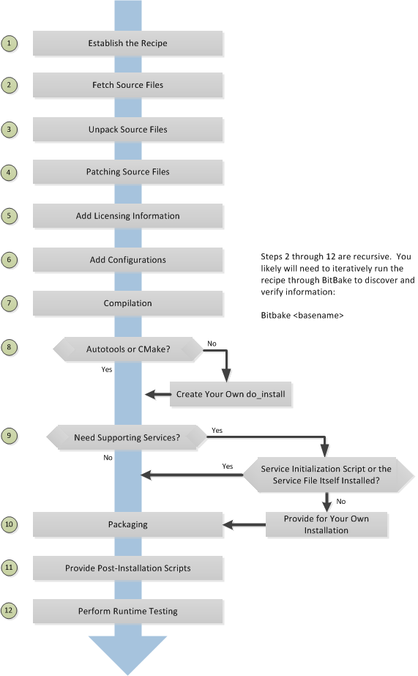
Recipe Workflow

Slide 9
Summary

Slide 10
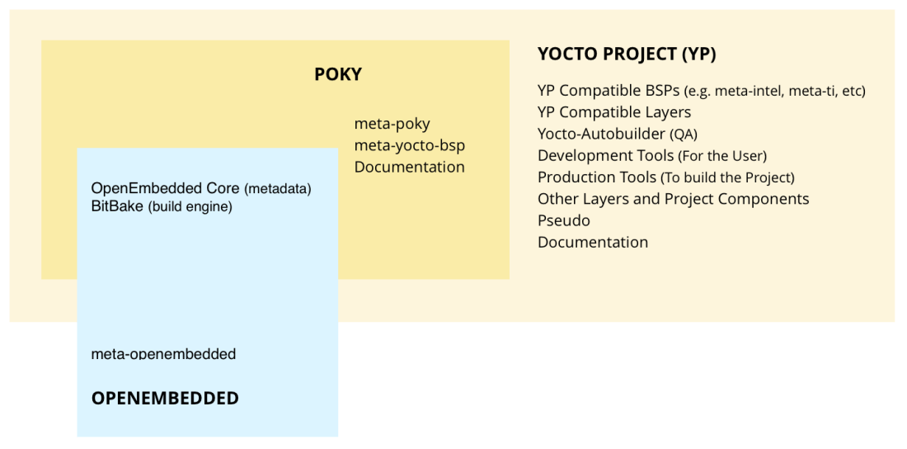
Components
Recipe is the most common form of metadata. A recipe will contain a list of settings and tasks (instructions) for building packages which are then used to build the binary image
Bitbake is a scheduler and execution engine which parses instructions (recipes) and configuration data.
oe-core or OpenEmbedded-Core is meta-data comprised of foundation recipes, classes and associated files

Slide 11
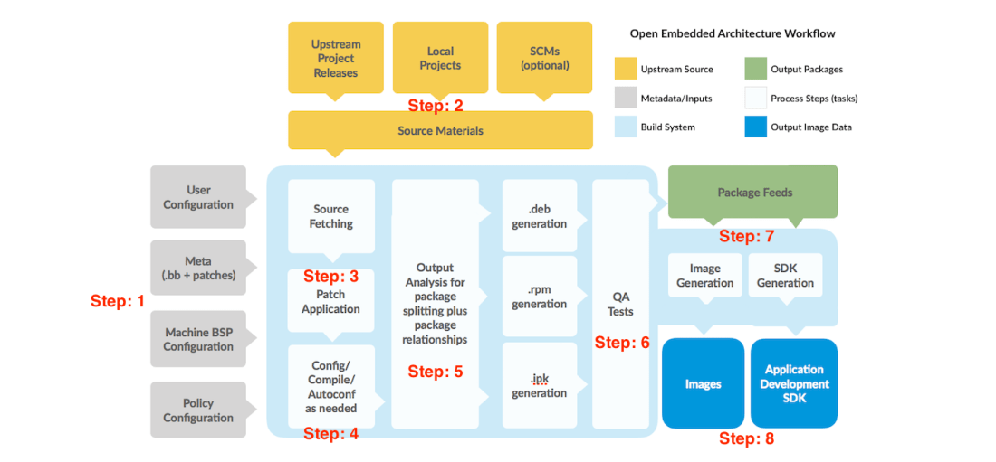
Yocto Project Workflow

Slide 12
Yocto Project Workflow
Step 1: Decide the various high-level configurations like what machine the image is to be built for, any special configuration data needed for the build, types of images to be built, etc.
Step 2: The source code can be in the form of tarballs, fetched from project releases or from Git or SVN or even be locally added to the workspace.
Step 3: Often, there may be a need to apply patches to the source code to tailor the software component to the desired machine or this specific image. These patches are applied next.

Slide 13
Yocto Project Workflow
Step 4: Most common build tools like autotools, cmake, etc. are supported. Bitbake takes care of doing the necessary configuration and compilation.
Step 5: The outputs of this build process are then placed into a temporary staging area where the packaging is done like .deb, .rpm, .ipk
Step 6: QA Tests
Step 7: Once the binary packages are ready, all that is necessary is to create a package feed that is suitable for the image that is requested.
Step 8: This package feed culminates with the creation of the final image!

